Slide 1
Chapter 1 From Zero to One (part 2)
Suffolk County Community College
CSE 222, Spring 2020

Slide 2
Topics:
Goals
Background
Managing Complexity
The Digital Abstraction
Von Neumann Architecture
Number Systems
Logic Gates (Combinational & Sequential Logic )
Logic Levels
CMOS Transistors
Power Consumption

Slide 3
Logic Gates
Logic Gates
Simple digit circuits
One or more inputs and one output
Relationship of inputs and output:
truth table;
boolean equation (boolean expression)
logical diagram symbol
Notes:
A device that performs a basic operation on electrical signals

Slide 4
Logic Gates
Perform logic functions:
inversion (NOT), AND, OR, NAND, NOR, etc.
Single-input:
NOT gate, buffer
Two-input:
AND, OR, XOR, NAND, NOR, XNOR
Multiple-input

Slide 5
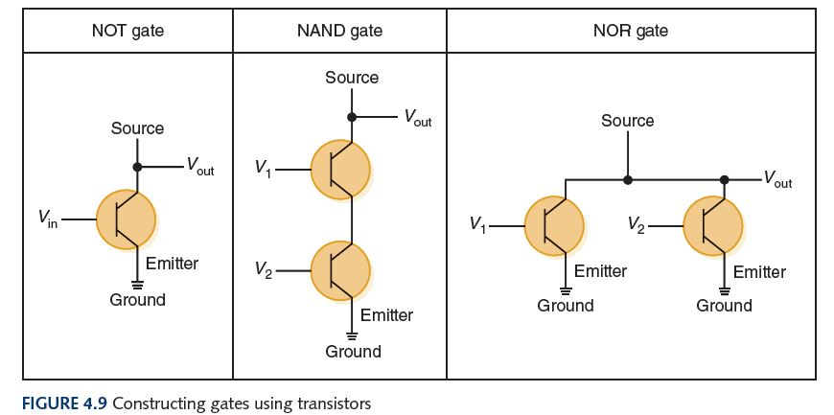
Logic Gates
Physical Gates
The easiest gates to create are the NOT, NAND, and NOR gates
Notes:
A device that performs a basic operation on electrical signals

Slide 6
Logic Gates
Perform logic functions:
Single-input:
Two-input:
AND, OR, XOR, NAND, NOR, XNOR
Multiple-input

Slide 7
Logic Gates
Perform logic functions:
Single-input:
Two-input:
Multiple-input

Slide 8
Logic Gates
Perform logic functions:
Single-input:
Two-input:
Multiple-input

Slide 9
Logic Gates
Perform logic functions:
Single-input:
Two-input:
Multiple-input

